Slide 1
Approach to Build a Data Warehouse

Slide 2
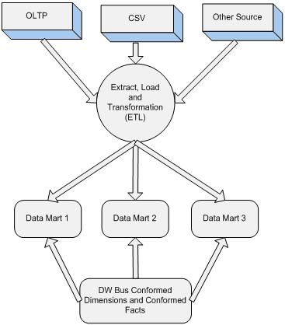
Bottom Up Approach

Slide 3
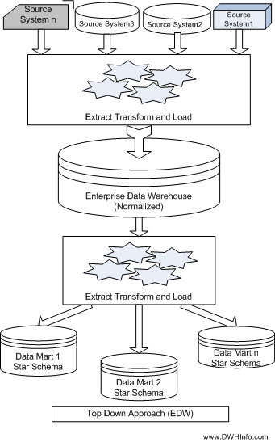
Top Down Approach

Slide 4
A Practical Approach
Plan and Define requirements
Create a surrounding architecture
Conform and Standardize the data Content
Implement Data Warehouse as series of super-mart one at a time.

Slide 5
An Incremental Approach
Distribution
Sales
Product
Glossary
Common Business
Metrics
Marketing
Customer
Accounts
Common Business Rules
Common Business Dimensions
Finance
Inventory
Vendors
Common Logical Subject Area ERD
Individual Architected Data Marts

Slide 6
The Eventual Result
Distribution
Sales
Product
Architected
Enterprise
Foundation
Marketing
Customer
Accounts
Finance
Inventory
Vendors
Enterprise Data Warehouse

